Slide 1
Round-Robin Test Base Data

Slide 2
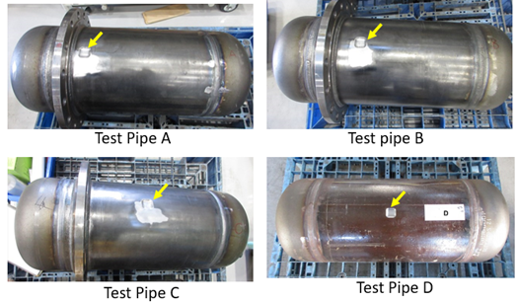
Overview of 4 test pipe

Slide 3
1.Basic Specifications
Test Pipe | A, B, C | D
Design Code | ASME Sec VIII Div-1
Design Temp. | 40Deg C
RSFa | 0.9
Material | JIS G3444 STK-400-E-G | JIS G3456 STPT370S
Spec. Min. Yield Stress at design temp.(MPa) | 235MPa | 215MPa
Spec. Min. Tensile Strength at design temp.(MPa) | 400MPa | 370MPa
Modulus of Elasticity (GPa) | 201 GPa
Poisson’s Ratio (-) | See API579-1/ASME FFS-1 2E.5.2
Allowable Stress(Mpa) | 100MPa (Note1) | 92MPa
Note1 : As no allowable stress is specified for this material as a pressure vessel material, the “allowable stress” was provisionally taken as the lower of the following two values: one-fourth of the specified minimum tensile strength of 400 MPa, and two-thirds of the specified yield strength of 235 MPa.

Slide 4
2.Actual Material Test Data
Test Pipe | A, B, C | D
Material | JIS G3444 STK-400-E-G | JIS G3456 STPT370S
Test temp.(℃) | 10.0 | 14.0
Yield Strength (MPa) | 431 | 303
Tensile Strength (MPa) | 488 | 472
Modulus of Elasticity (GPa) | 206 | 208
Poisson’s Ratio(-) | 0.29 | 0.28
Allowable Stress | 100MPa | 92MPa

Slide 5
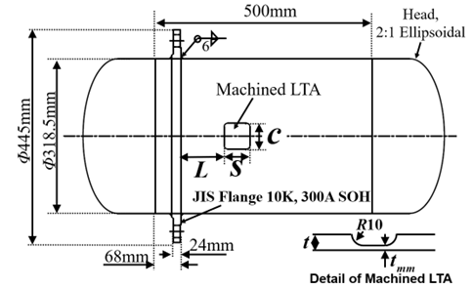
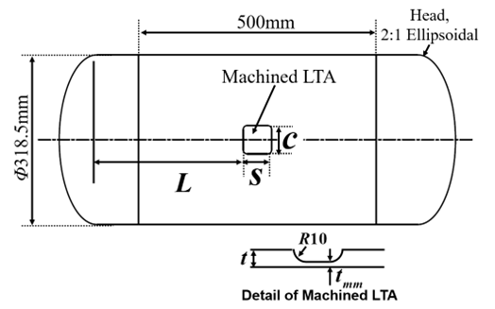
3.Test Pipe Size Data
Test Pipe | A | B | C | D
Cylindrical Shell OD(mm) | 318.5 | 38.5 | 318.5 | 318.5
Original Thickness (mm) | 9.2 | 9.2 | 9.2 | 10.7
t_{mm} (mm) | 2.0 | 2.0 | 2.0 | 7.1
s(mm) | 35.24 | 35.18 | 35.24 | 30.16
c(mm) | 35.25 | 34.94 | 35.09 | 29.34
2:1 Ellip. Head Thick.(mm) | 10.3 | 10.3 | 10.3 | 14.0
Distance to MSD, L(mm) | 17 | 53 | 160 | 310.5
75mm

Slide 6
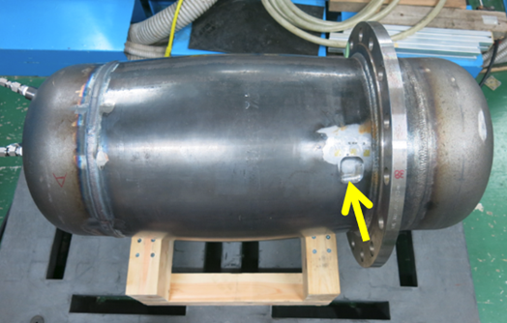
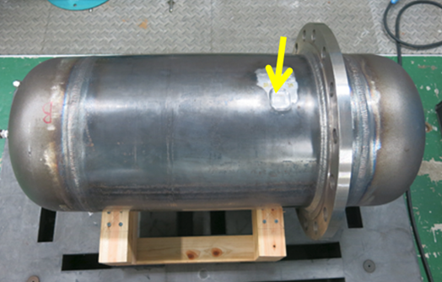
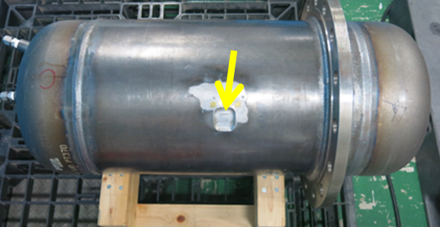
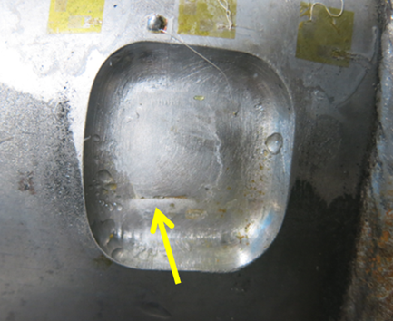
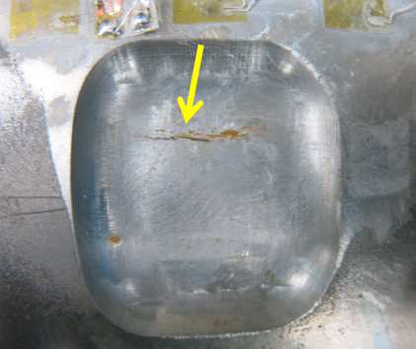
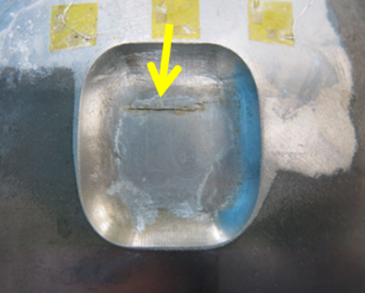
3.Test Results
Test PipeA
Failed Press.：31.6MPa
Test PipeB
Failed Press.：30.1MPa
Test PipeC
Failed Press.：28.8MPa
A;40 x Speed Video
B;40 x Speed Video
C;40 x Speed Video倍速動画
A;0.1 Speed Video
B;0.1 x Speed video
C;0.1 x Speed Video

Slide 7
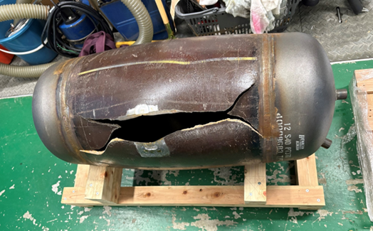
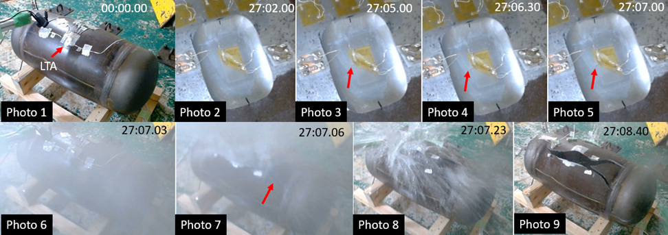
4.Test Results (Cont’d)
Test PipeD
Failed Press.：32.6MPa
D;40 x Spee Video
D;.01 x Speed Video
D; Slow-motion video showing signs of cracking

